Slide 1
Java Introduction
Chapter 1

Slide 2
Previous Class
The History and Evolution of Java

Slide 3
How Java Changed the Internet
Java Applets
- “An applet is an application designed to be transmitted over the Internet and executed by a Java-compatible Web browser”
Security :
No virus, no malicious code, JVM sandbox
Portability :
-Bytecode
Servlets: Java on the Server Side

Slide 4
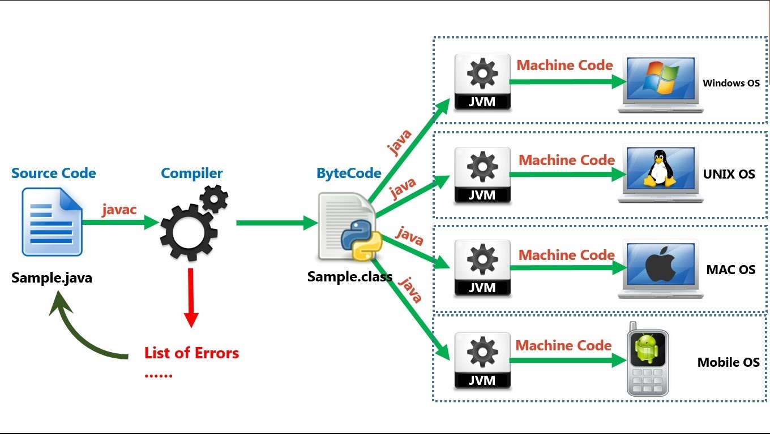
Java code compilation

Slide 5
Why Java?
Simple
Object Oriented (everything is an object)
Robust
Multi threading
Architecture-Neutral
Interpreted and High Performance
Distributed
Dynamic

Slide 6
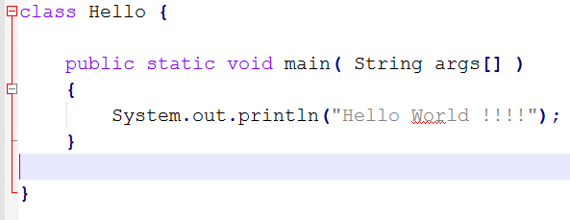
A first Simple program
Compilation : Demo
Execution : Demo

Slide 7
A first Simple program
Compilation :
Execution : Demo

Slide 8
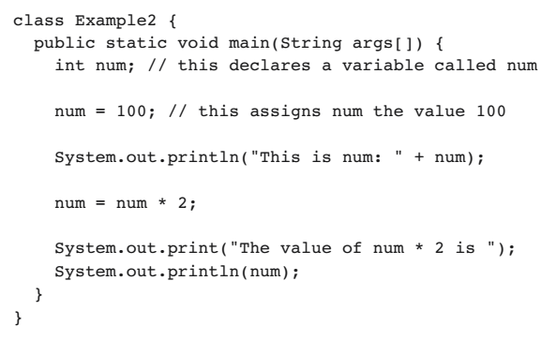
2nd Simple program
Compilation :
Execution :

Slide 9
